Slide 1

Welcome to BookMyMandap: Your Dream Venue Awaits
Discover the hassle-free way to find and book Mandaps, designed to connect users and providers effortlessly. Our platform creates seamless event experiences by simplifying the entire venue booking journey.

Slide 2

The Problem: Traditional Venue Booking is a Headache
Time-Consuming Searches
Lack of Transparency
Pricing and venue availability remain unclear, frustrating users and providers alike.
Users spend over 40 hours navigating through scattered information, making endless phone calls to find a suitable Mandap.
Disorganized Process
Poor communication and outdated listings result in inefficient booking experiences.

Slide 3
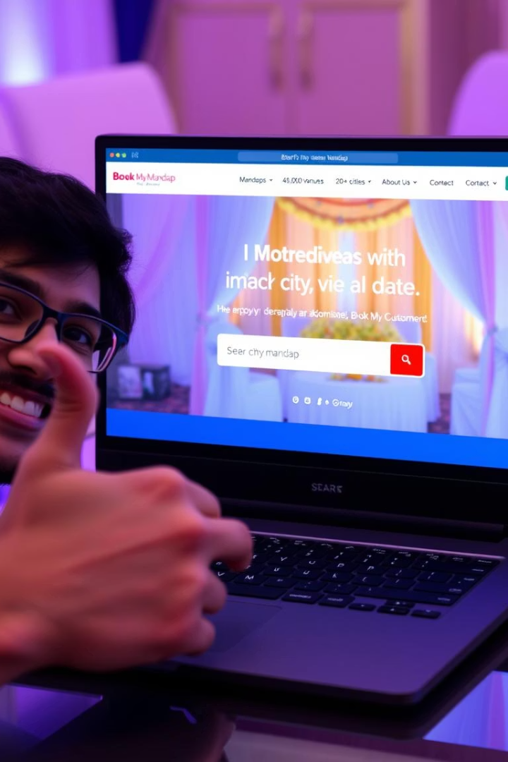
Our Solution: BookMyMandap - Simplifying Venue Booking
Unified Platform
Streamlined Experience
Connecting users directly with Mandap providers on a single easy-to-use platform.
Efficient search, booking, and management tools reduce time and effort.
Transparent & Organized
Clear pricing, availability, and secure transactions ensure trust and convenience.

Slide 4



Technology Stack Behind BookMyMandap
Frontend Technologies
React.js for dynamic UI
Sonner for elegant notifications
Backend & Database
React Big Calendar for scheduling
Node.js runtime server-side
Recharts for visual data
Express.js API framework
Moment.js for date handling
Bcrypt for password security
Ant Design UI components
Nodemon for live reloads
Zustand for state management
JWT for secure authentication
Typewriter-effect for animations
MongoDB for NoSQL data storage
React Router for navigation
Tailwind CSS for fast styling

Slide 5
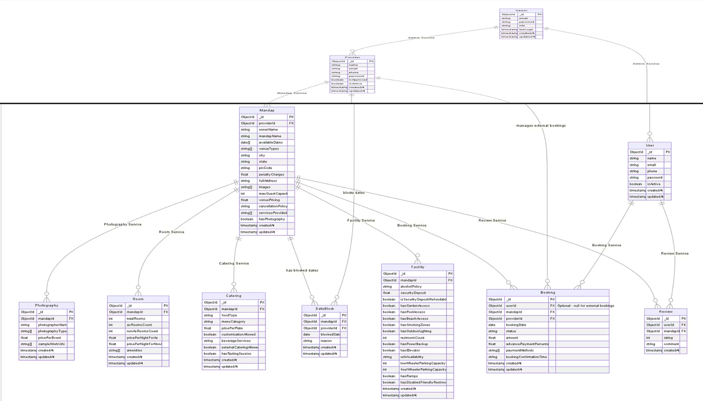

Slide 6

PROVIDER'S PERSPECTIVE

Slide 7
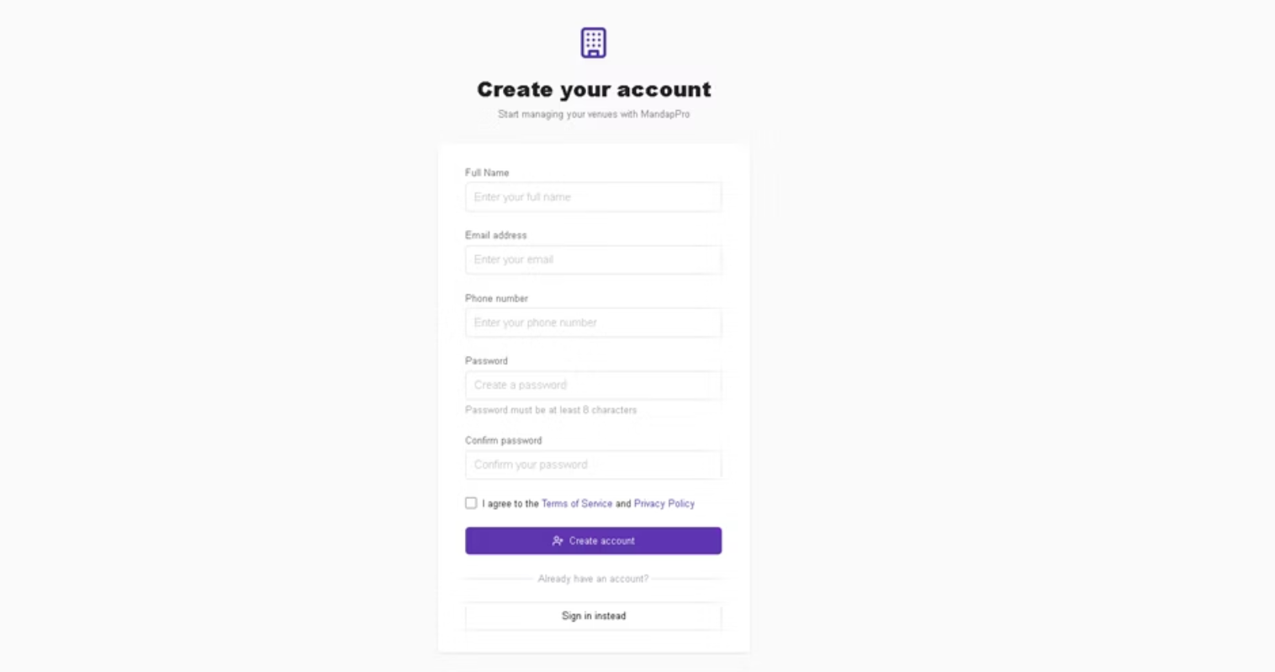
Provider Registration Page

Slide 8
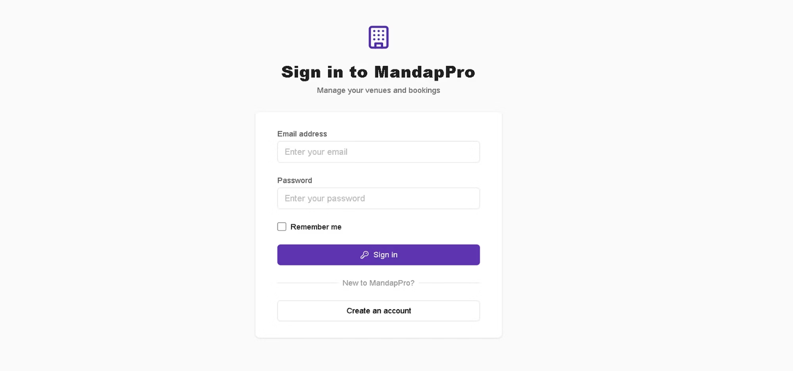
Provider Login Page

Slide 9
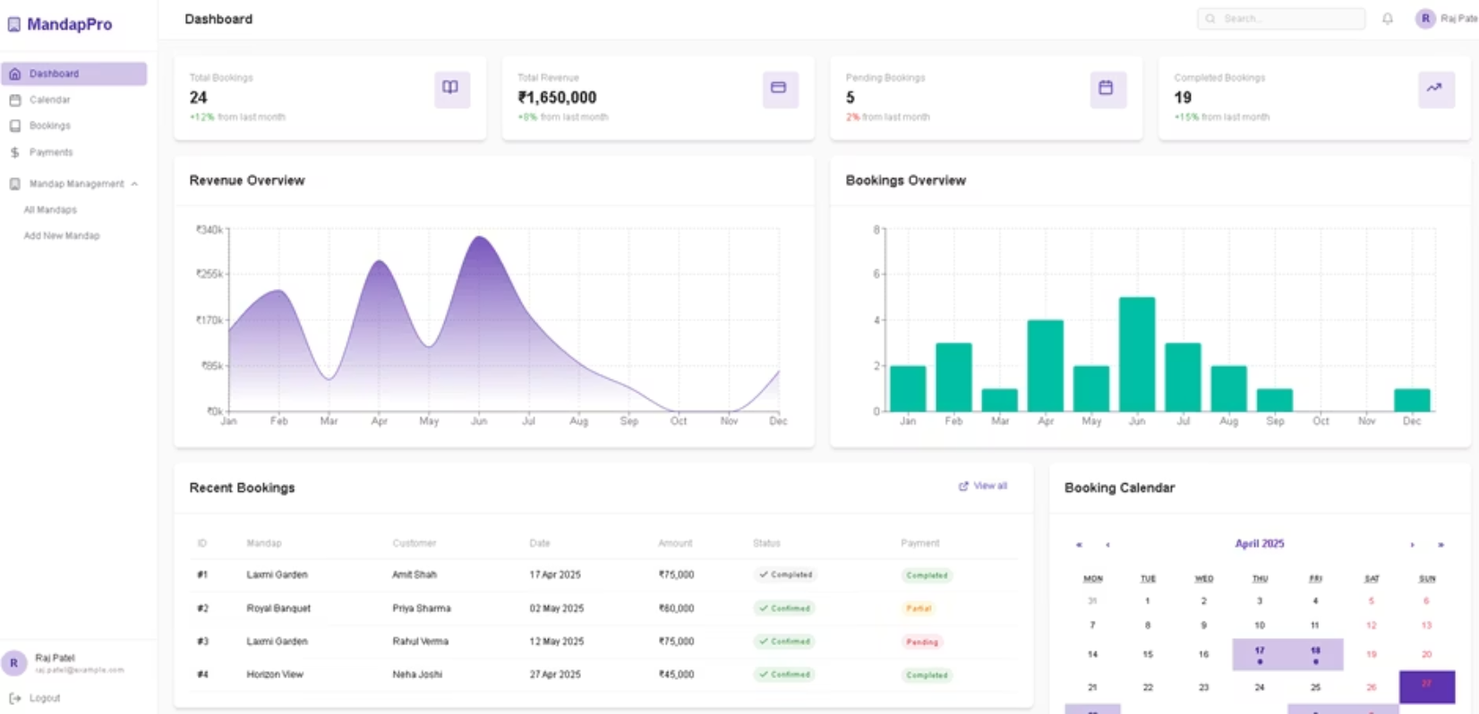
Provider Dashboard

Slide 10
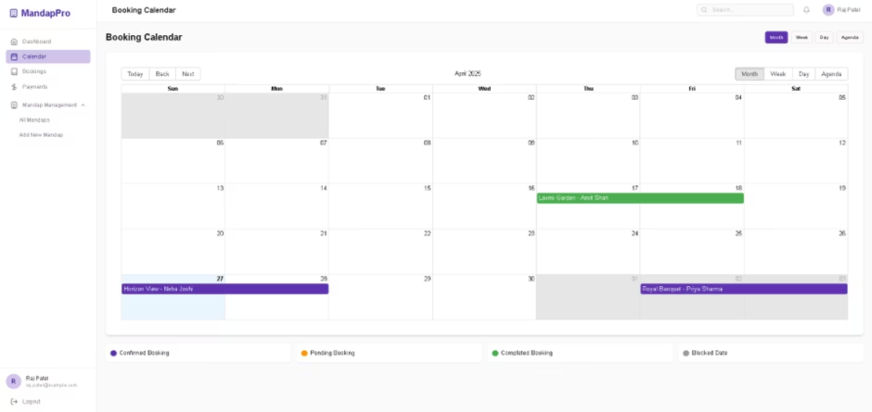
Booking Calendar

Slide 11
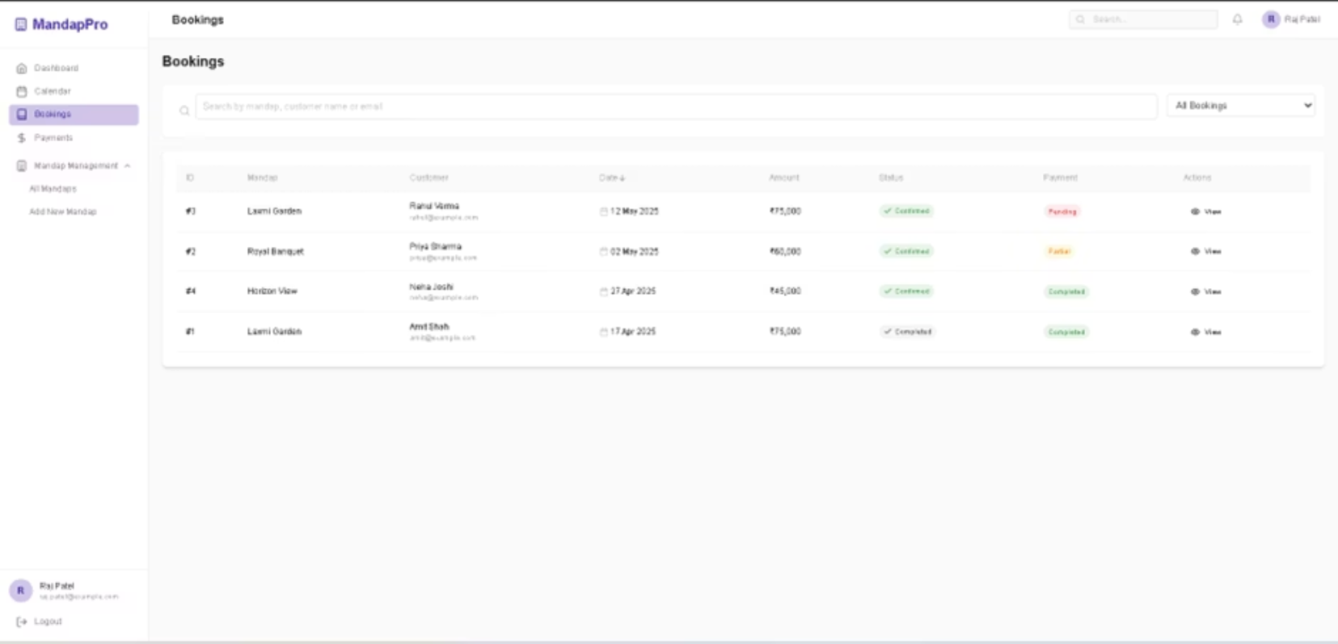
Provider's Bookings

Slide 12
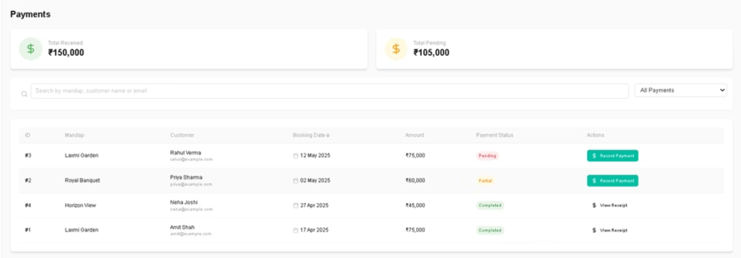
Payment History

Slide 13
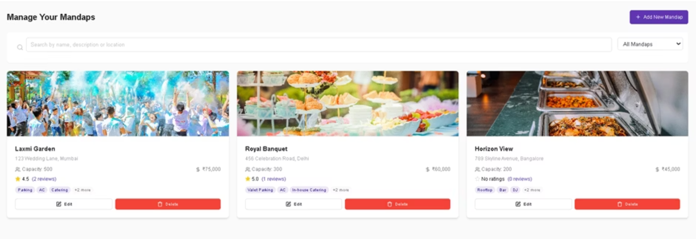
Manage Your Mandap

Slide 14
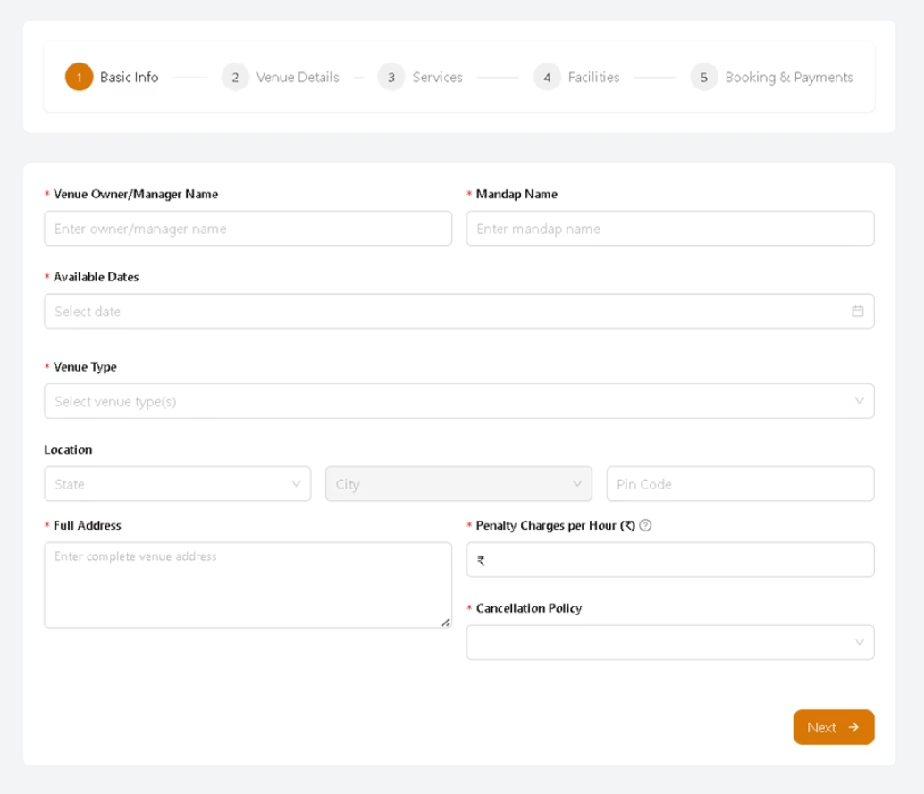
Add New Mandap

Slide 15
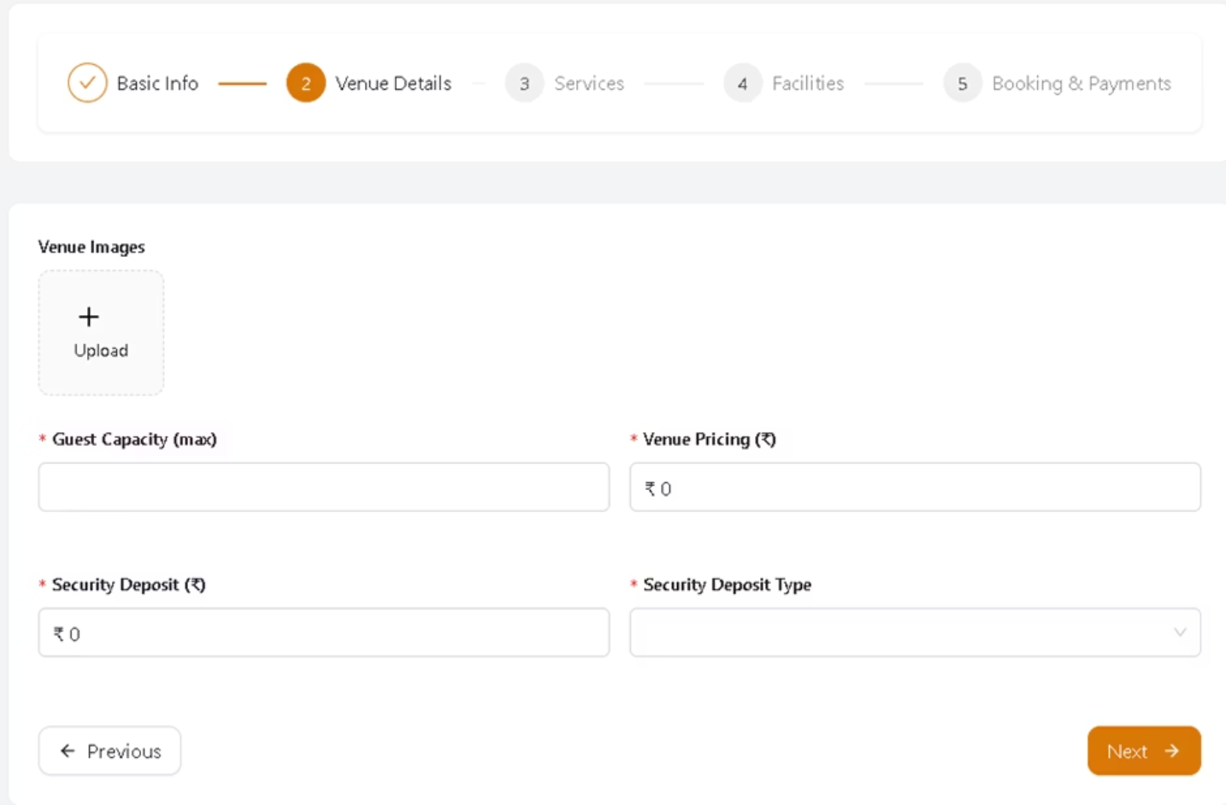

Slide 16
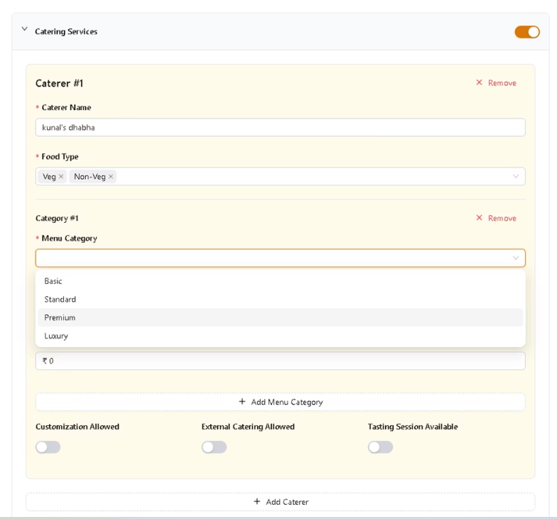
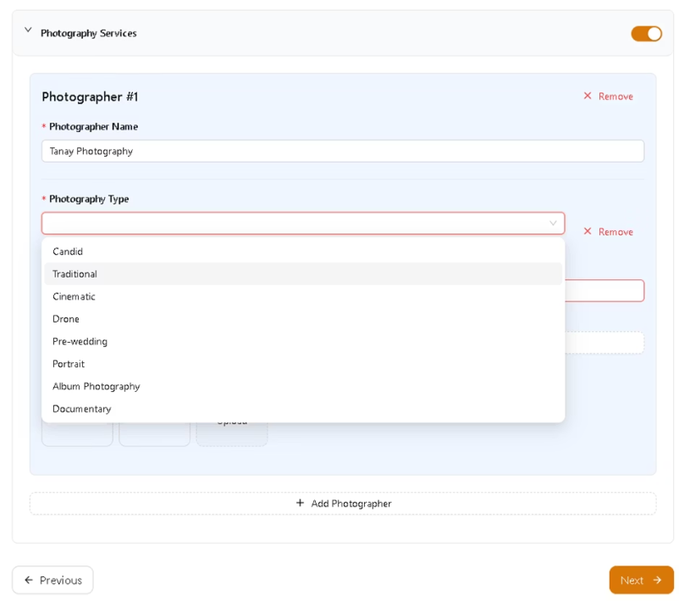

Slide 17
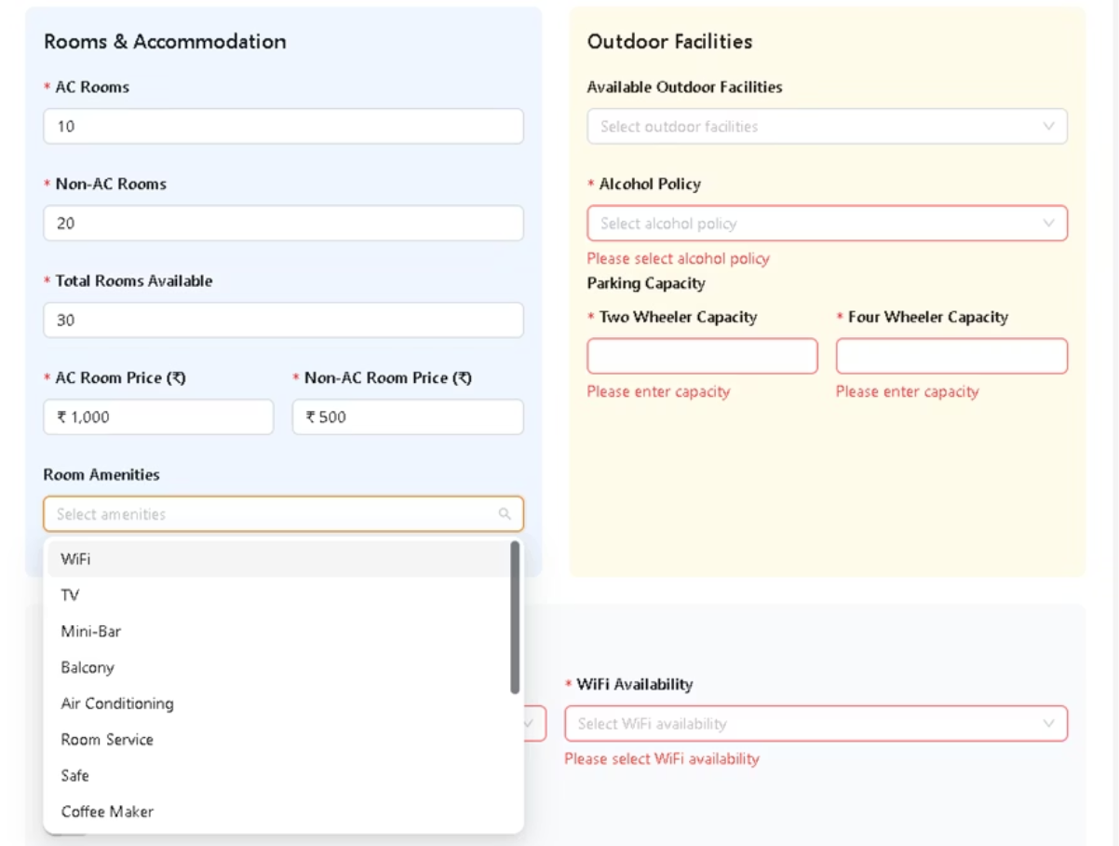

Slide 18
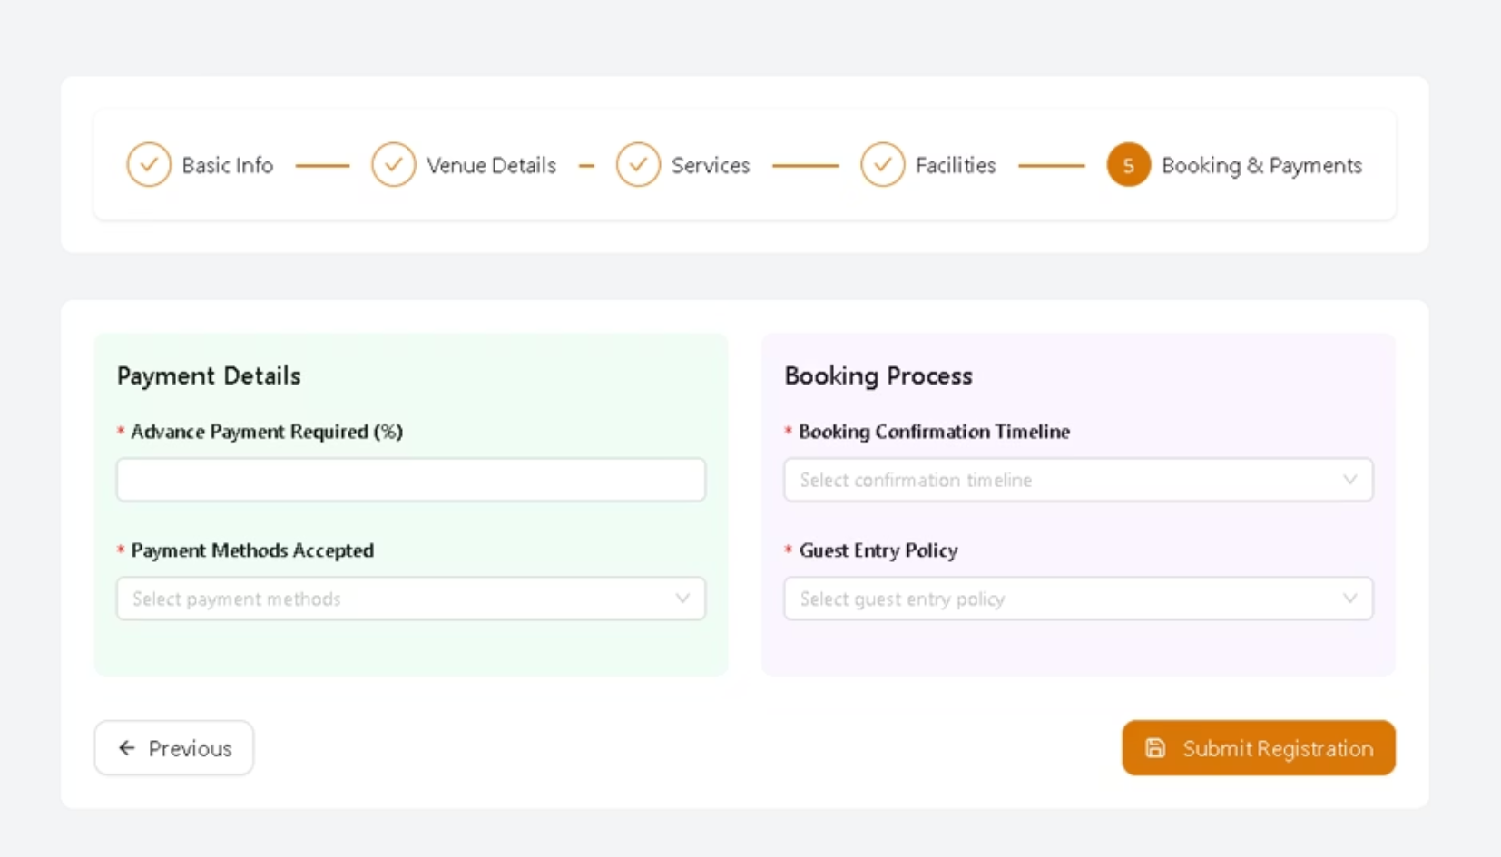

Slide 19

ADMIN PERSPECTIVE

Slide 20
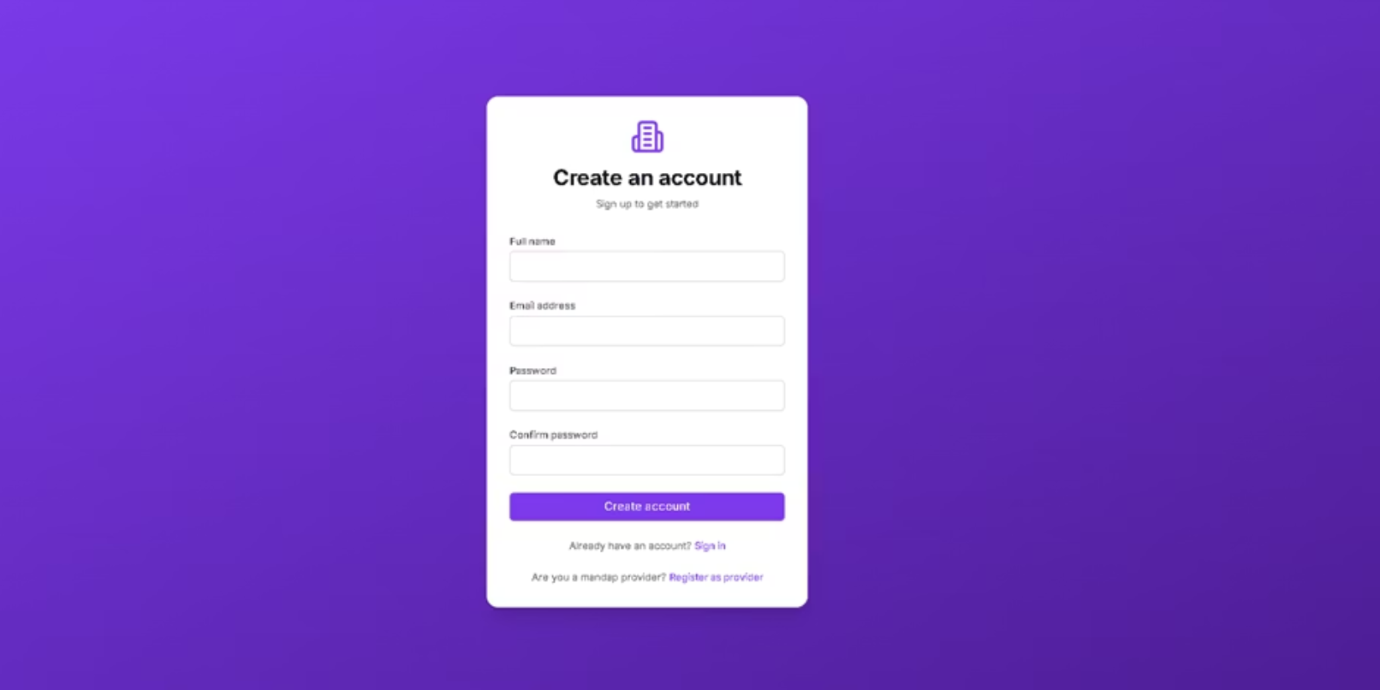
Admin Registration

Slide 21
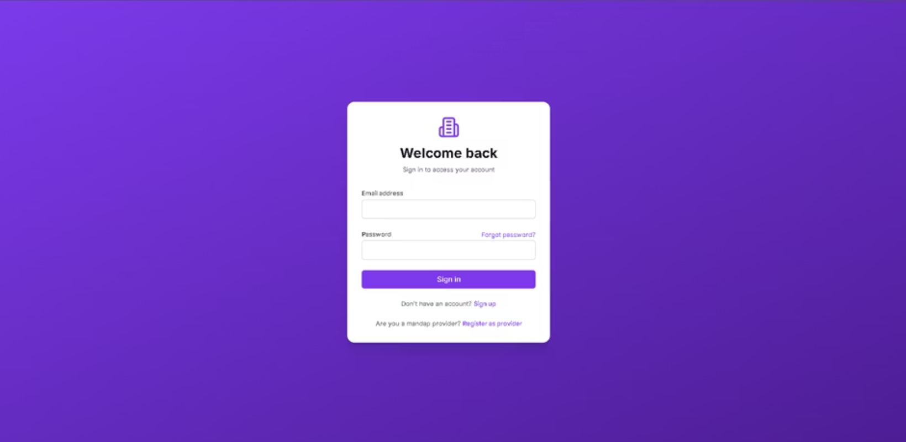
Admin Login

Slide 22
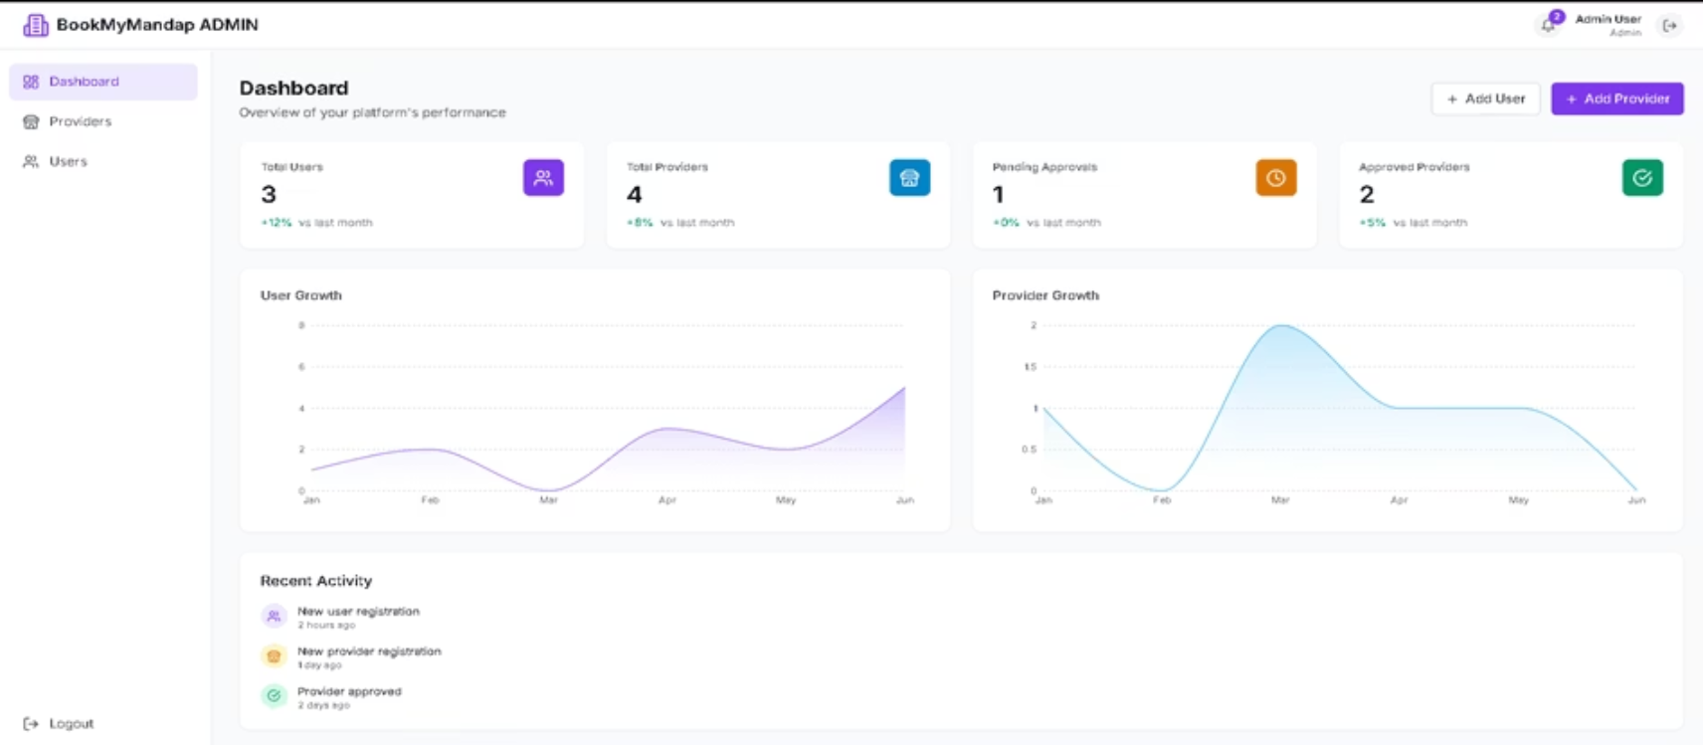
Admin Dashboard

Slide 23
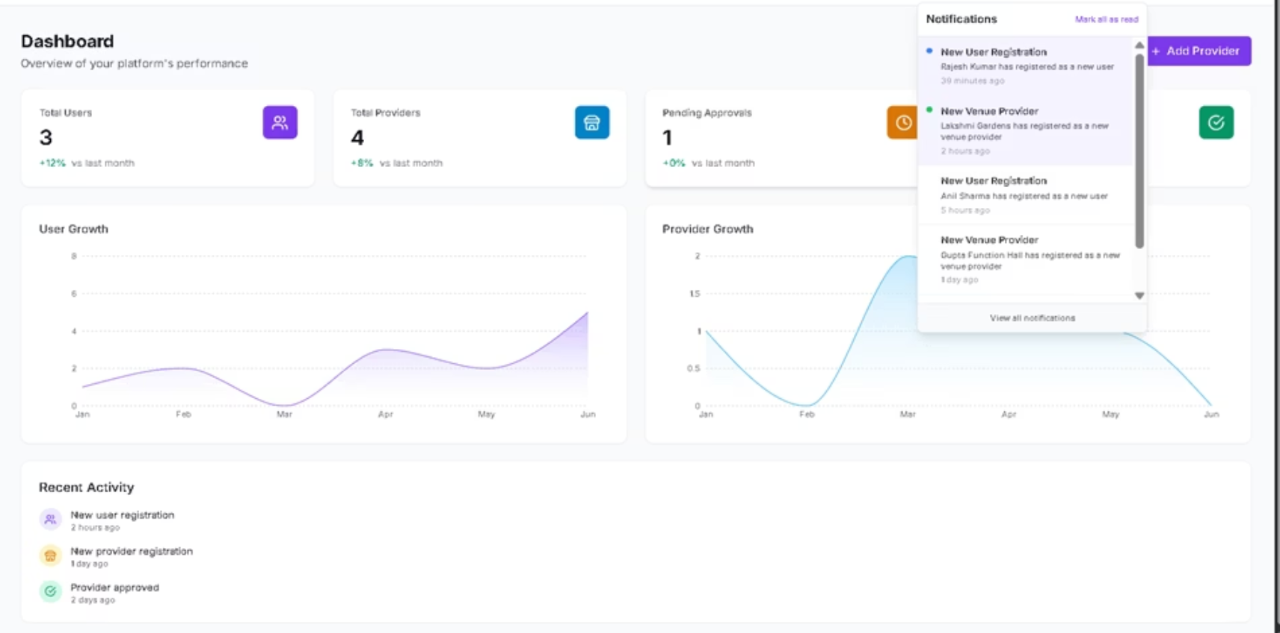

Slide 24
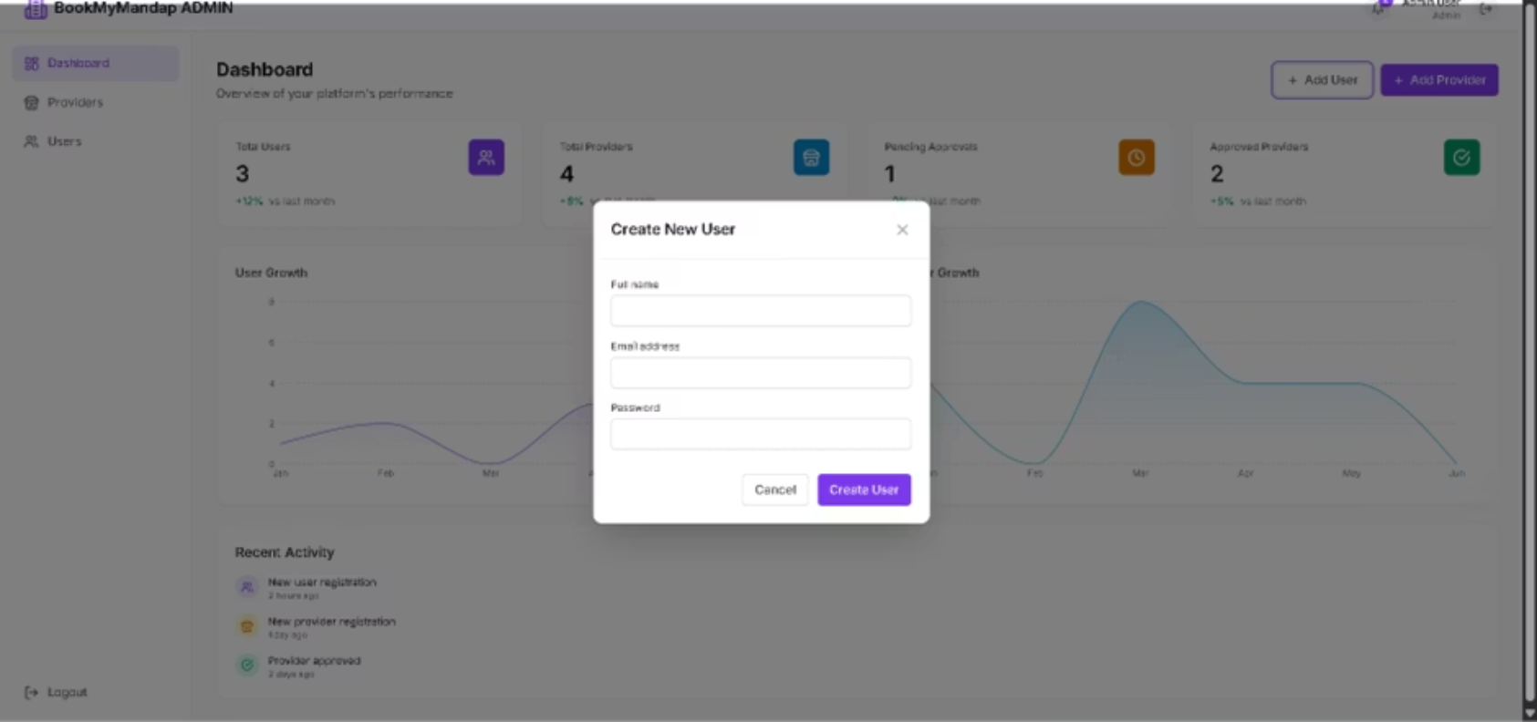
Add User

Slide 25
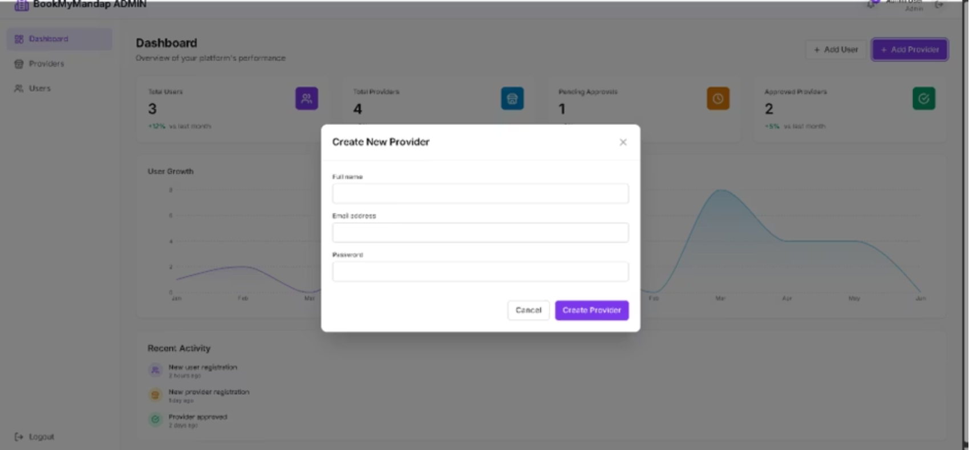
Add Provider

Slide 26
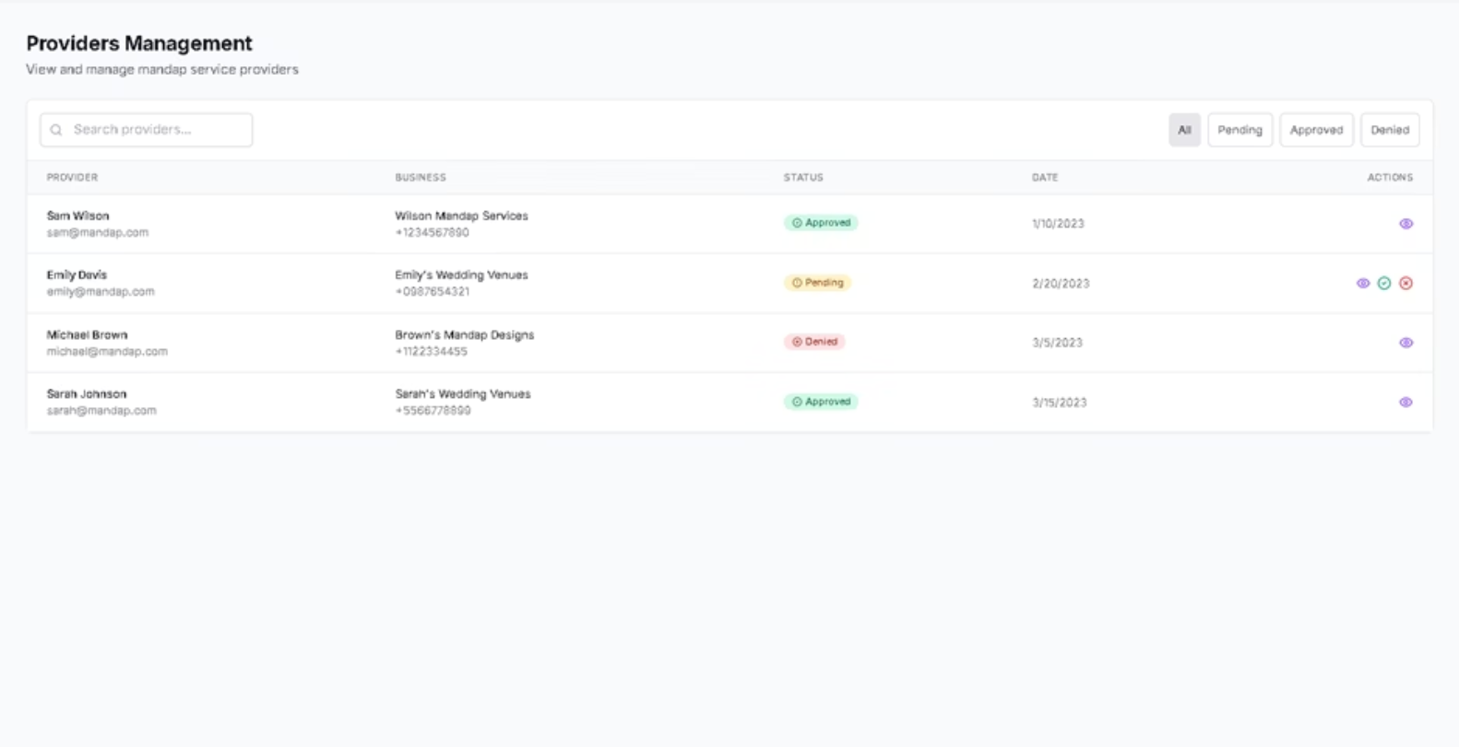
Manage provider

Slide 27
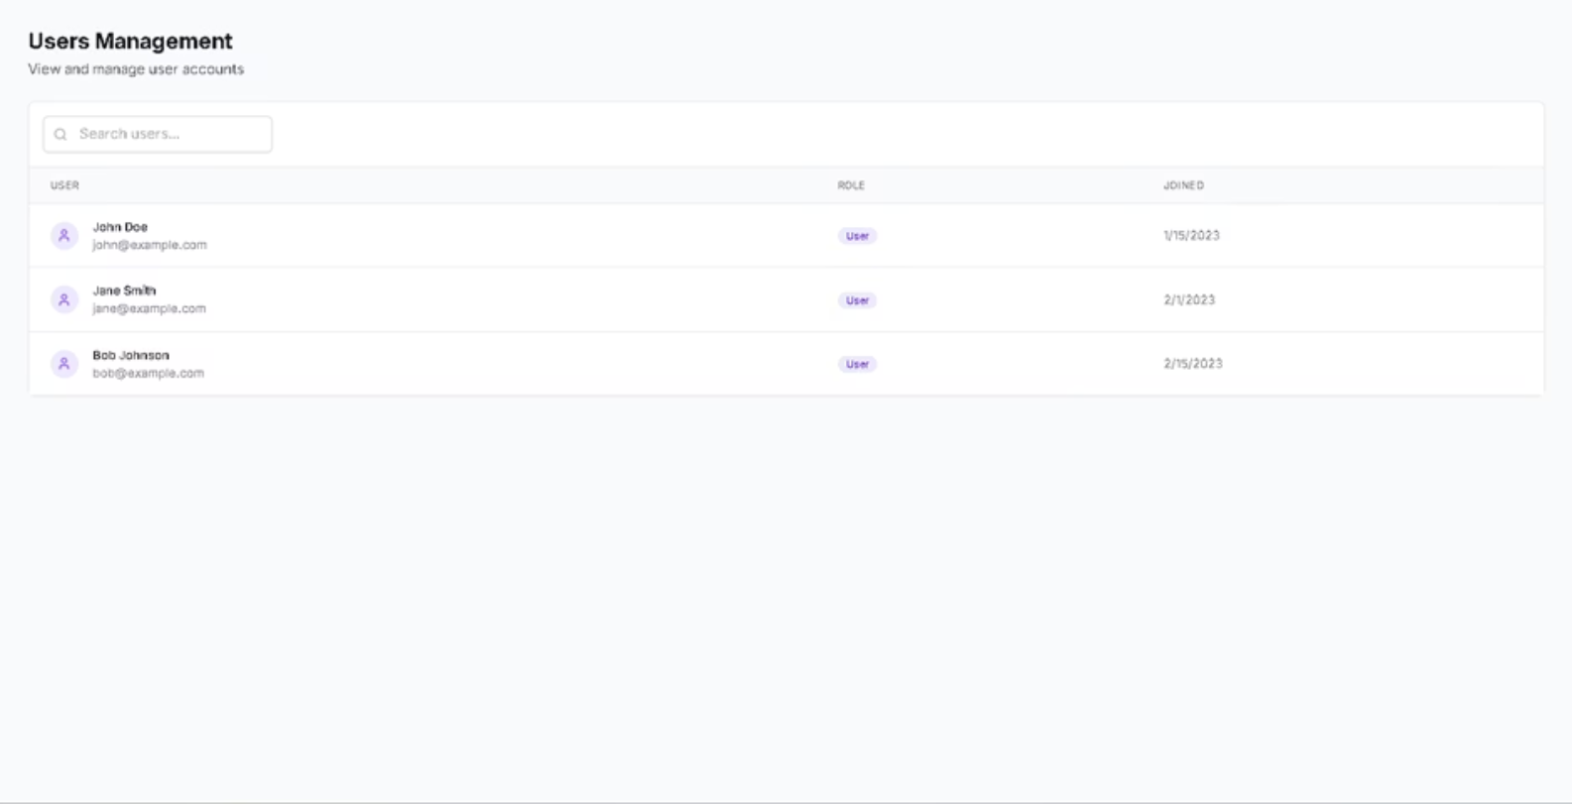
Manage User

Slide 28

BookMyMandap: Let's Create Unforgettable Events Together
Join thousands who trust BookMyMandap for effortless venue booking. Experience the future of event planning with convenience and confidence at your fingertips. Contact us today to learn how we can help make your special day truly unforgettable.

